Slide 1
Punctuations, Stasis & Gradualism

Slide 2
Schedule
T, 1-Dec | Format | Th, 3-Dec | Format | T, 8-Dec | Format
Mariana Gelambi (10 min) | 10 | Caitlin Carey | 10 | Fernanda Vasquez-Valverde | 15
Alaina Weinheimer (10 min) | 10 | Guilherme Dalponti | 10 | Kaitlyn Malewicz | 15
Tommy Phannareth | 10 | Camilo Alfonso | 15 | Bailey Howell | 15
 |  | Carolina Martinez-Gutierrez | 15 | Erika Goldschmidt | 10
 |  | Connor Brown | 15 | Duke Chiu | 10
 |  | Sean McHugh | 10

Slide 3
Presentation rubric
1. Introduce sufficient biological background on research topic
2. Presents a coherent research question with explicit connection made to actual research conducted
3. Methodology explained. Relevant assumptions identified/justified/defended.
4. Data sources and structure described sufficiently.
5. Results correctly interpreted in terms of biological question. (Units, parameters, in understandable, biological terms!)
6. Appropriate model caveats and violated assumptions identified, suggestions for methods that may answer the question better.
Additional components:
1. Well organized and clearly presented (limited amount of text)
2. Timing (lightening or full)
3. Clear and concise delivery

Slide 4
Why is it important to study macroevolution?
Are patterns different between micro and macroevolution? Are processes different between micro and macroevolution?

Slide 5
Breakout groups: Write down answers to the following questions
1. What processes only operate at macroevolutionary scales?
2. What is Punctuated Equilibrium (PE)?
3. What process generates the pattern? Be as specific as you can about the exact mechanism.
4. What are the implications of PE for our understanding of macroevolution?
5. Do you think it is controversial? Why or why not?

Slide 6
What is the relationship between speciation and trait change?
Is evolution faster in small or large populations?
How do micro and macroevolutionary rates compare?

Slide 7
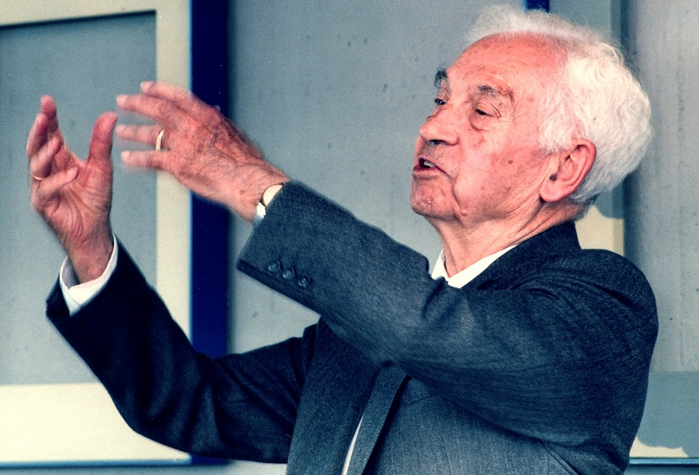
Ernst Mayr - BSC & speciation

Slide 8

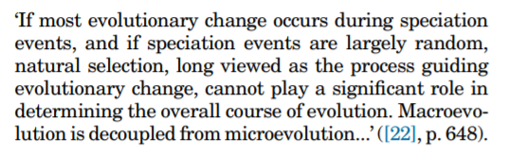
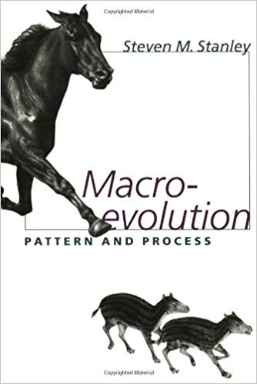

Slide 9
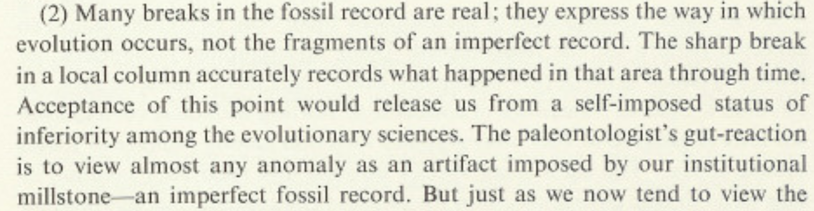
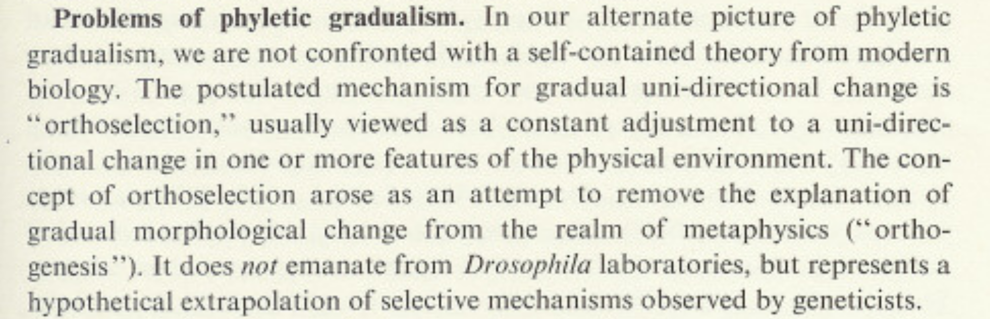

Slide 10
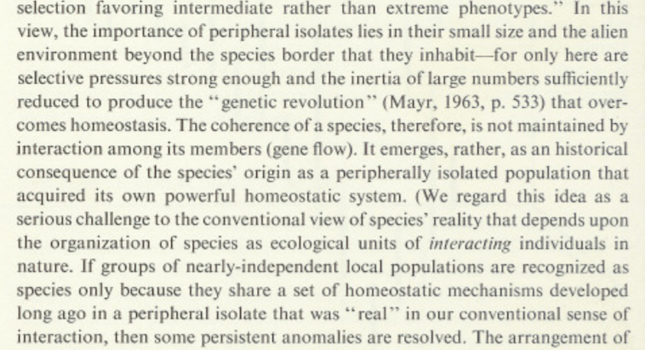

Slide 11
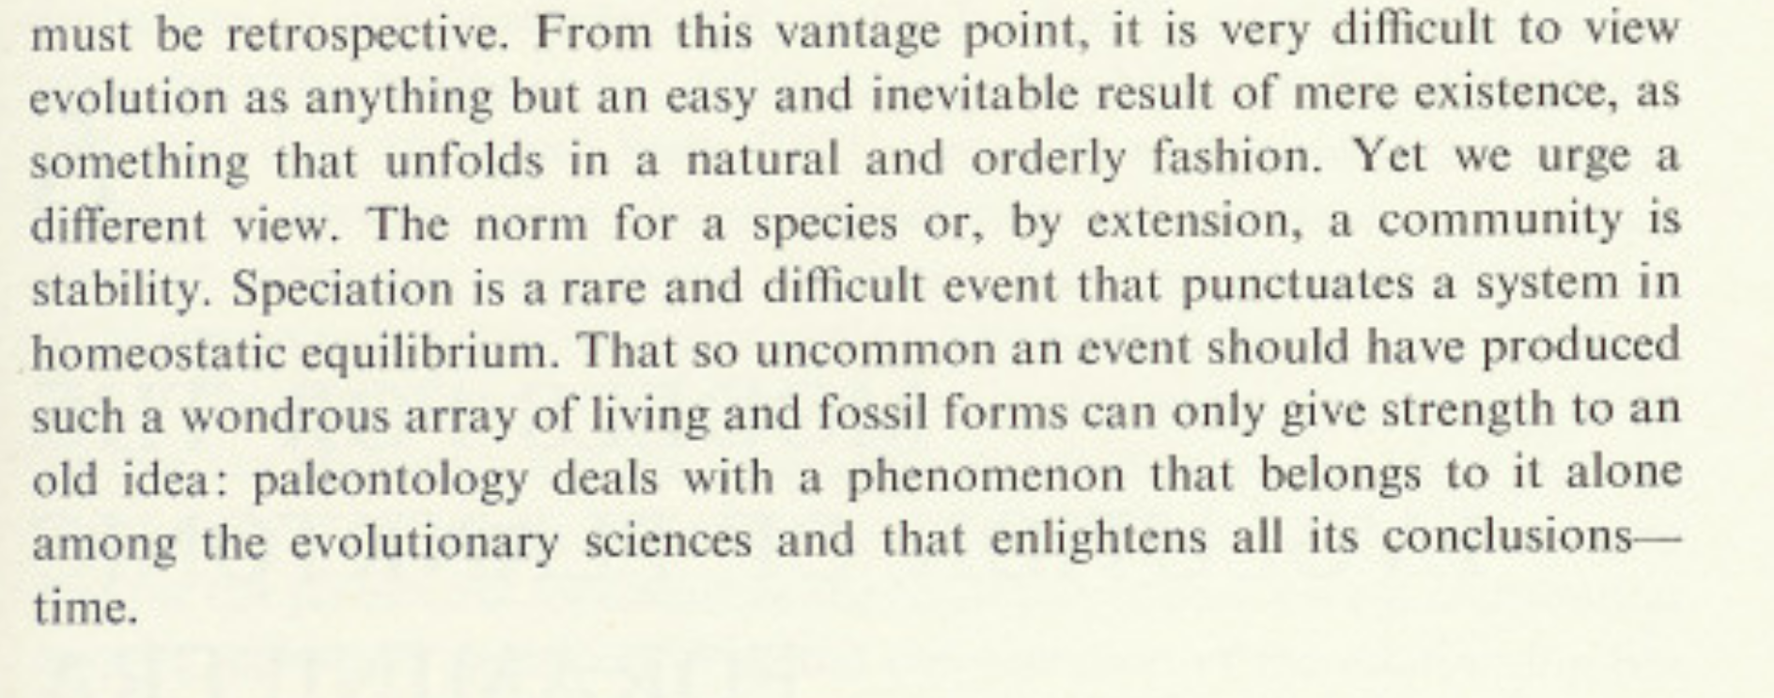

Slide 12
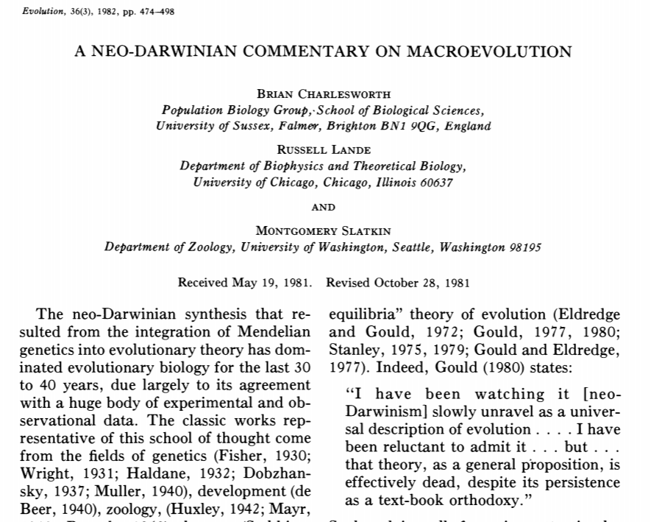
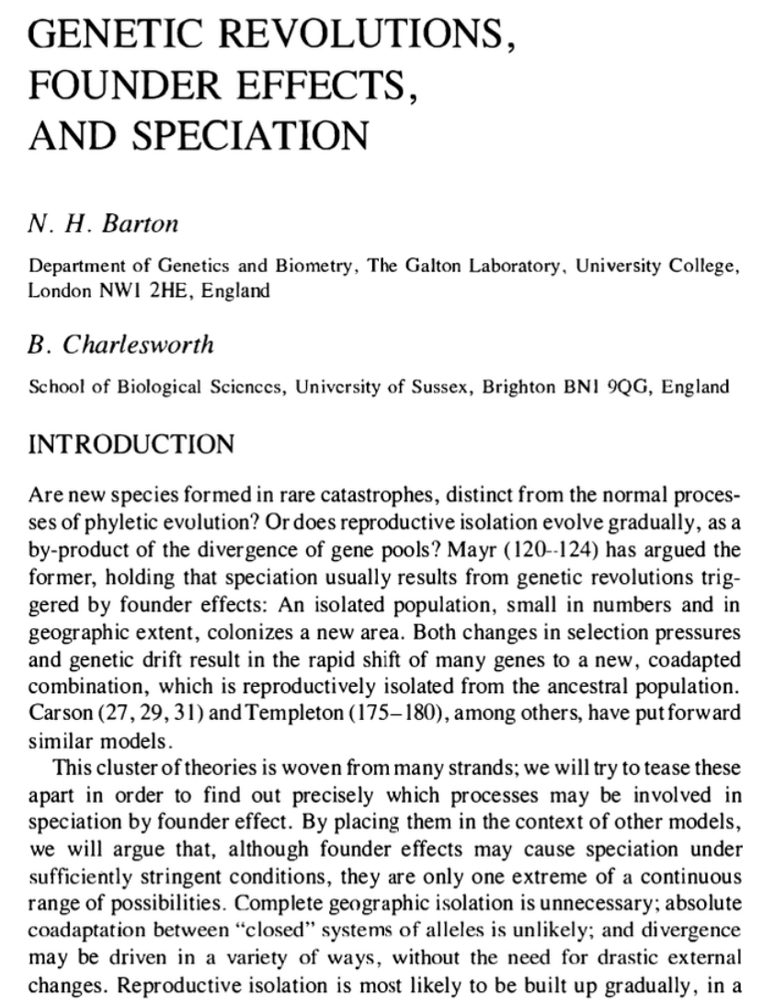

Slide 13
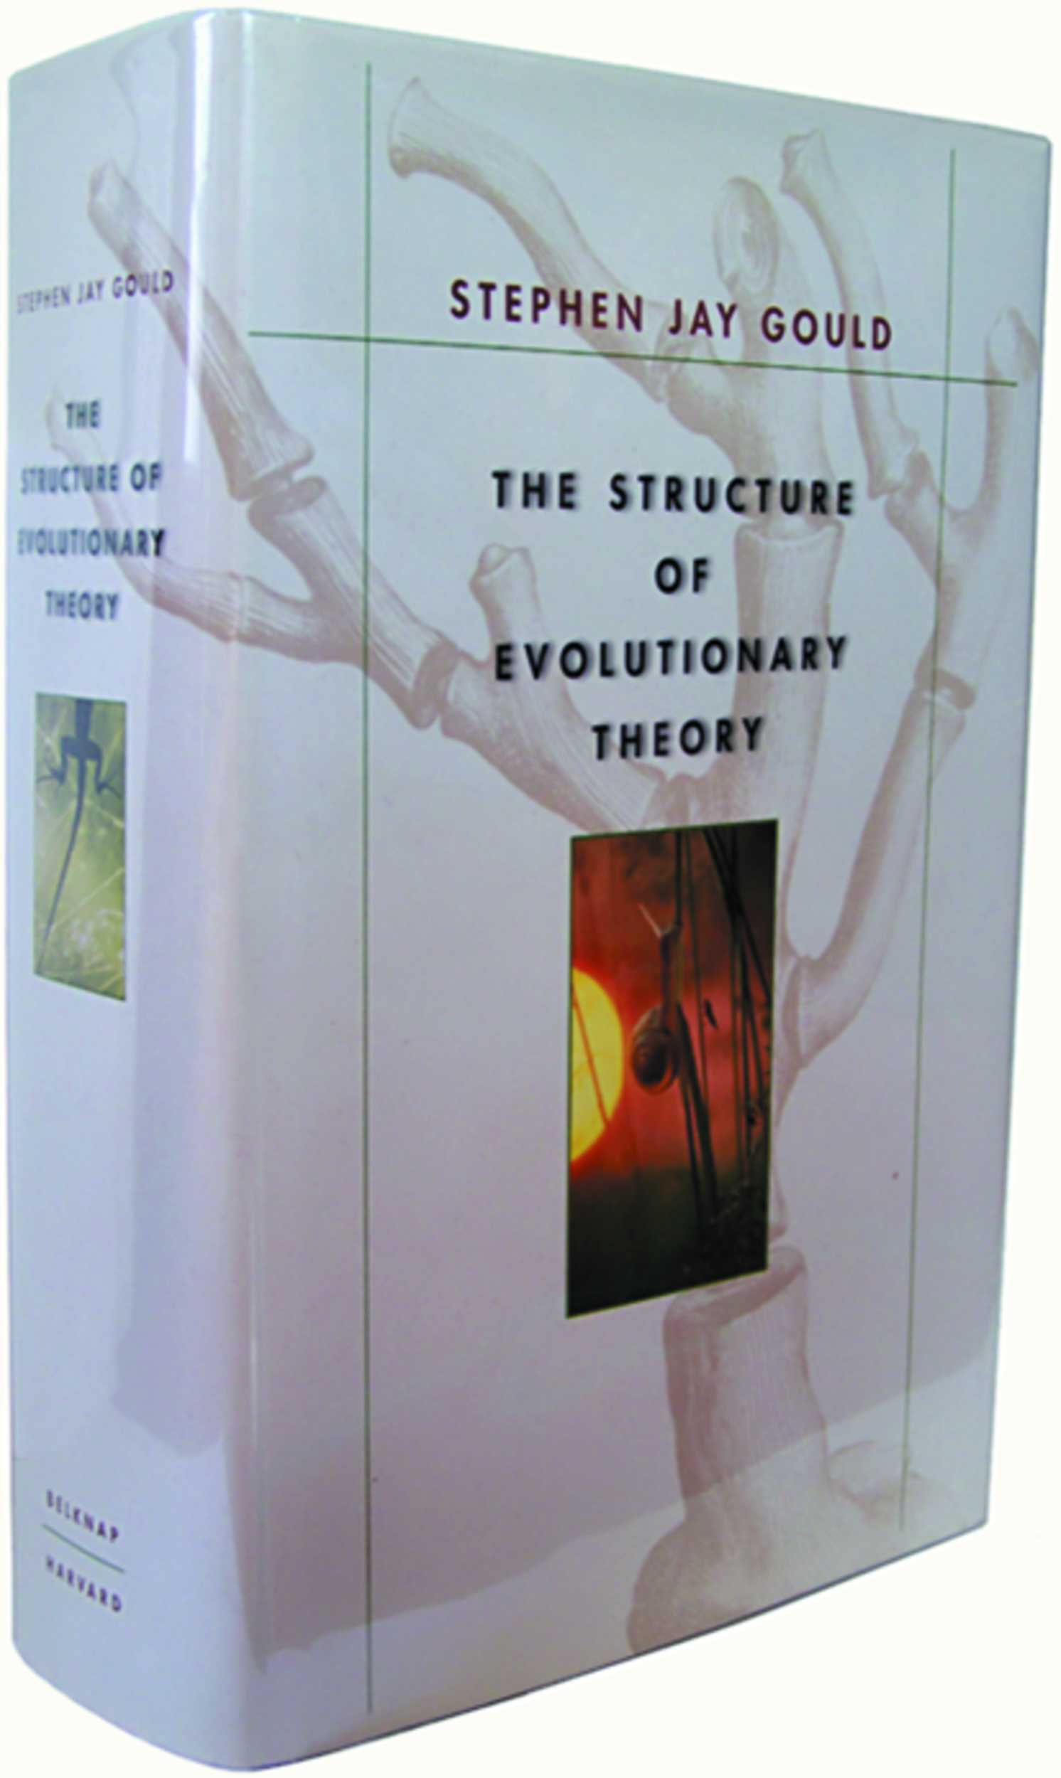
Gould's big book

Slide 14
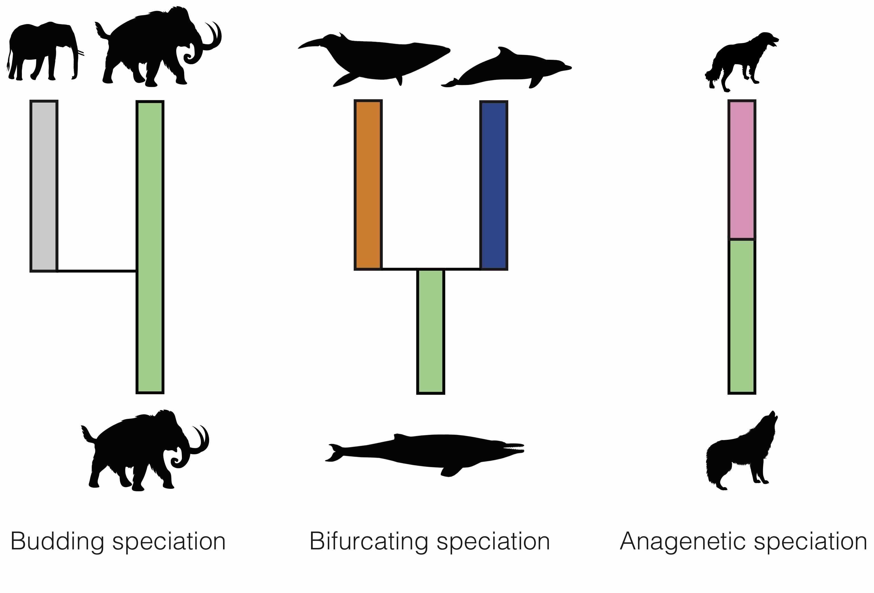
Testable in the fossil record?
Morphospecies
Is speciation visible?
New modes for paleodata:
Budding speciation
Anagenetic speciation

Slide 15
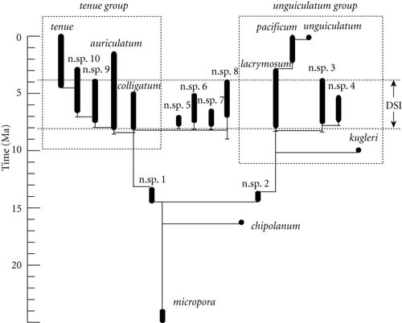
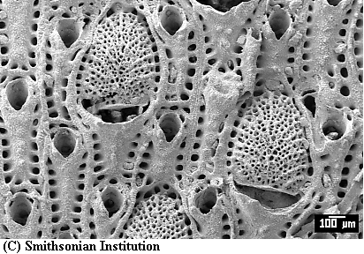
Testable in the fossil record?
Bryozoans: Metrarabdatos

Slide 16
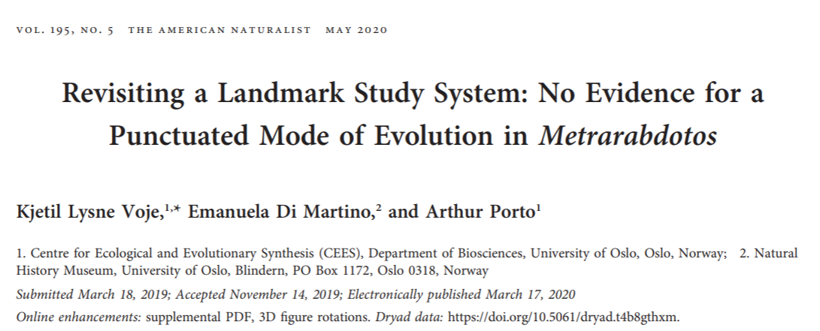

Problems with original analysis:
Not respecting scale (ordinal & nominal traits); differences meaningless in terms of magnitude
Replacing missing values with species means

Slide 17
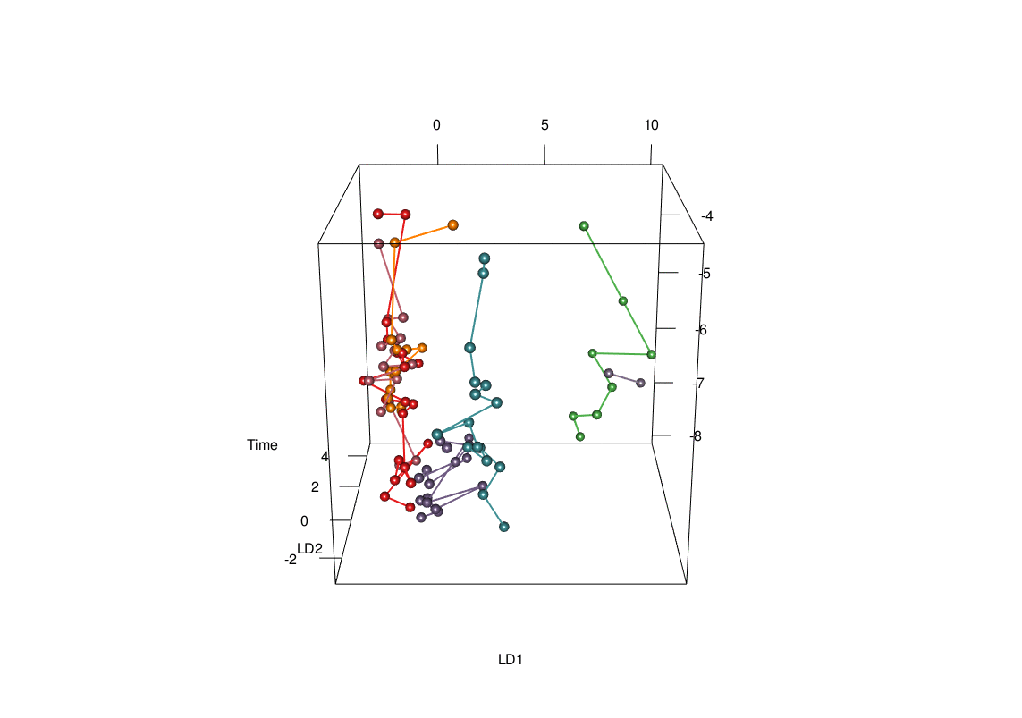
“We failed to find differences in evolutionary rates between anagenesis and cladogenesis in our reanalysis of a
subset of the Metrarabdotos data. Separate lineages are not occupying distinct places in multivariate space but show large fluctuations that overlap extensively”

Slide 18
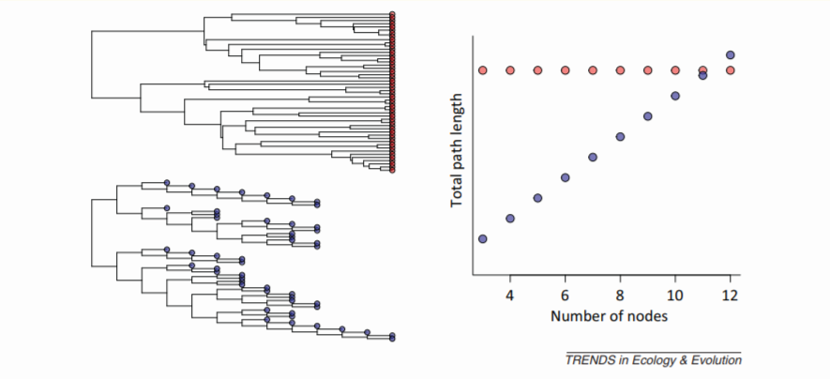
Testable with PCMs?

Slide 19
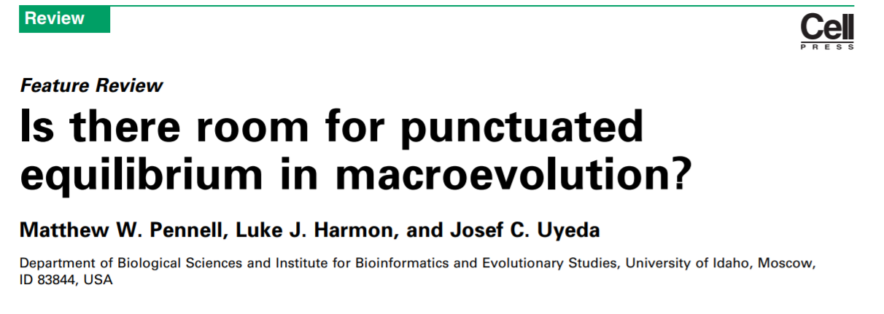
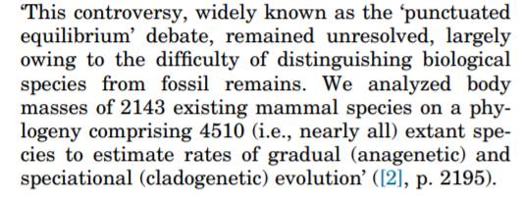
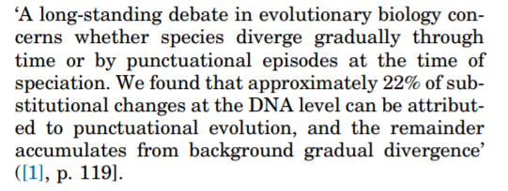
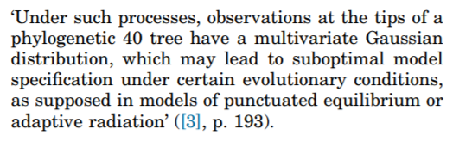
Our argument...

Slide 20
Our argument... “PE” is 4 distinct questions
1. What is the relative importance of gradualistic versus pulsed evolution?
2. What is the role of speciational events (cladogenesis) versus within lineage evolution (anagenesis) in generating trait divergence?
3. When change is cladogenetic, are these changes adaptive or driven by neutral processes?
4. How important is higher level selection (species selection) in shaping patterns of diversity?

Slide 21
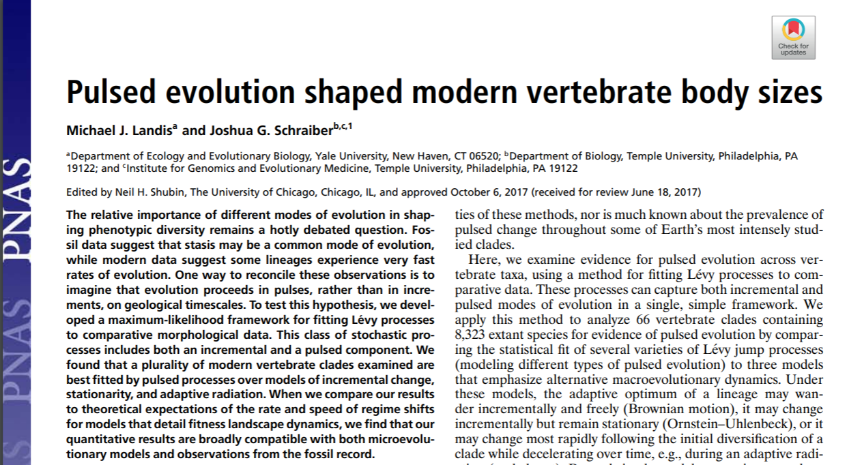
Pulsed evolution is common (gradual anagenetic change is too)

Slide 22
Speciation rates are correlated to trait change

Slide 23
Less clear if speciation is a significant cause of pulsed evolution; or an effect of another factor - still controversial
Does speciation cause adaptive radiation?
Does failure to speciate prevent some species from adapting?

Slide 24
The other side of the coin...Stasis
“Stasis is data”
Microevolutionary theory can explain punctuations, but can it explain stasis?

Slide 25
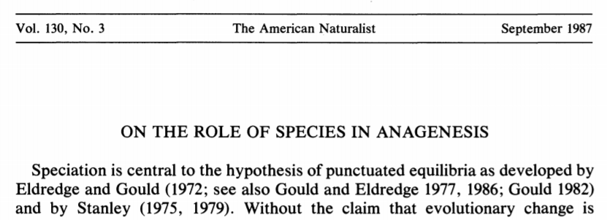

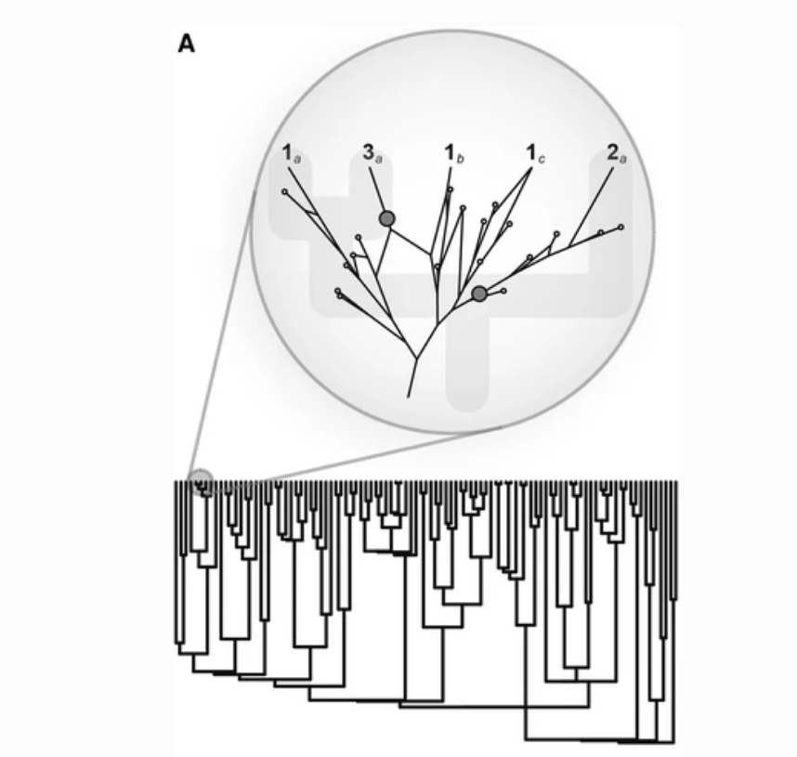
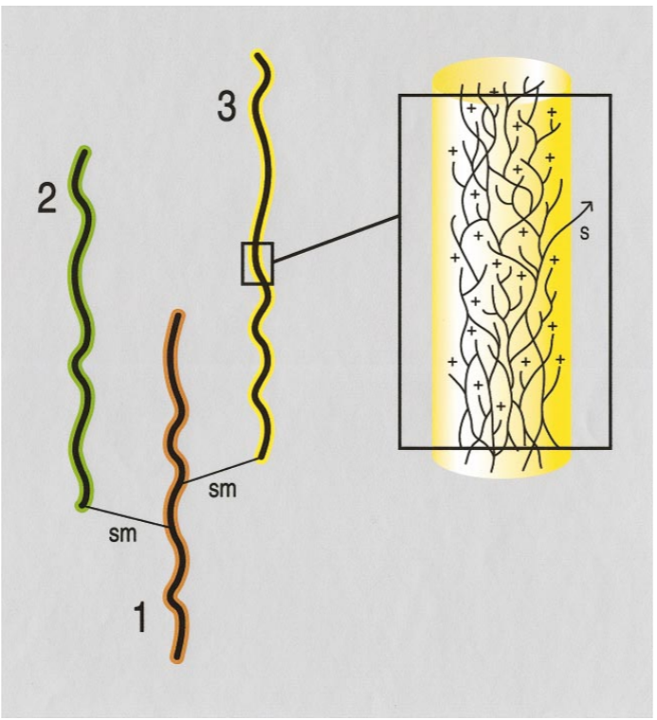
Ephemeral divergence model
Doug Futuyma
related: Ephemeral
speciation

Slide 26
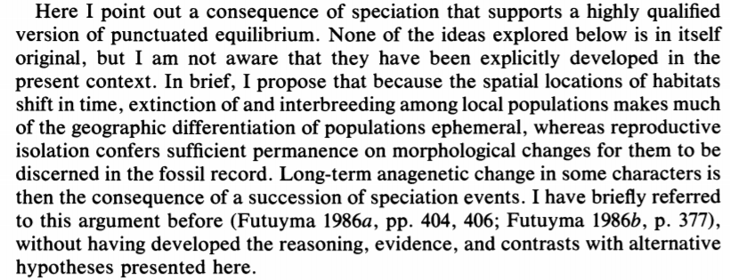
Rescued version of PE?

